Slide 1
Chapter 37

Slide 2
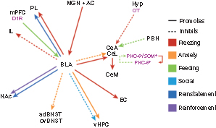
Figure 1 Projection-specific effects as shown by optogenetic or pharmacogenetic manipulation. The solid or dotted lines indicate the promotion or inhibition of certain behaviors. The basolateral complex of the amygdala (BLA) encompasses the lateral and basal nuclei. Specific cell types are shown in pink. For simplicity, projections that are anatomically or electrophysiologically defined but have not been shown to have a causal relationship with behavior are omitted. AC, auditory cortex; adBNST, anterodorsal bed nucleus of the stria terminalis; CeA, central nucleus of the amygdala; CeL, lateral CeA; CeM, medial CeA; D1R, dopamine 1 receptor; EC, entorhinal cortex; Hyp, hypothalamus; IL, infralimbic; MGN, medial geniculate nucleus; mPFC, medial prefrontal cortex; NAc, nucleus accumbens; OT, oxytocin; ovBNST, oval nucleus of the BNST; PBN, parabrachial nucleus; PKC, protein kinase C; PL, prelimbic; SOM, somatostatin; vHPC, ventral hippocampus.⁵

Slide 3
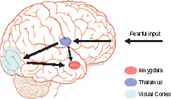
Figure 2 Two-pathway hypothesis for amygdala activation to fear. The short, rapid thalamic route is shown with the dashed arrow, the longer cortical pathway with bold arrows. (For clarity subcortical structures are shown overlaid on brain surface).

Slide 4
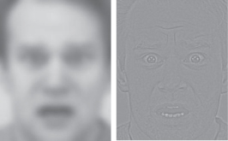
Figure 3 The rapid subcortical pathway may allow low-frequency inputs (left image) to reach the amygdala rapidly, while finely detailed images (right) are further processed in cortical regions (e.g., fusiform gyrus).

